Slide 1
Exception handling
Lecture - 30

Slide 2
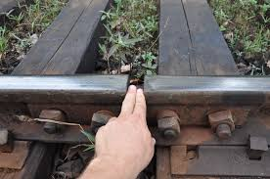
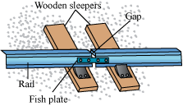
Did you notice the gaps between two rail tracks???
Notes:
Explanation: obj.elementAt(1) returns the value stored at index 1, which is 2.

Slide 3
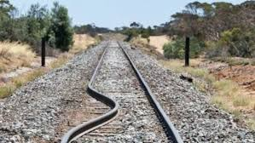
Why???
In summer, due to heat, iron will expand
If there is no gap between the tracks, it will bend
Thermal Expansion

Slide 4
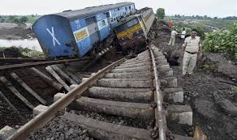
Result???
Accidents!!!

Slide 5
So, We have to rectify that accidents
That’s why we are having gaps between the rail tracks
An exception is handled here

Slide 6
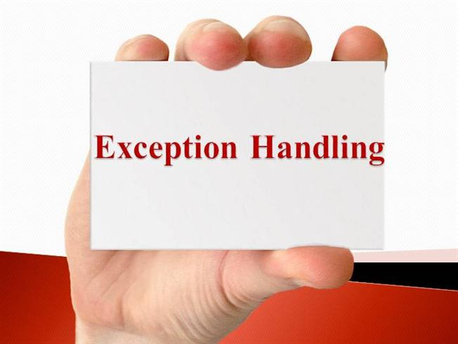
Similarly in Java also we may get problems
How to handle it?????

Slide 7


Exception
Abnormal condition or not coming under any rule

Slide 8
Exception in Java
In Java, an exception is an event that disrupts the normal flow of the program.
It is an object which is thrown at runtime.

Slide 9
Exception Handling in Java
Exception Handling is a mechanism to handle runtime errors
Runtime errors
ClassNotFoundException,
IOException,
SQLException,
RemoteException, etc.

Slide 10

Compile time error
run time error
What is the difference???

Slide 11
public class Test
{
public static void main(String a[])
{
System.out.println("Hello")
}
}
Compile time error
Error:
C:\Sample>Javac Test.java Test.java:3: error: ';' expected System.out.println("Hello")
Output : ?????
Syntax Errors

Slide 12
public class Test
{
public static void main(String a[])
{
int arr[]=new int[5];
arr[10]=20;
}
}
Run time error
Error:
Exception in thread "main" java.lang.ArrayIndexOutOfBoundsException: 10 at Test.main(Test.java:6)
Output : ?????
logical Errors

Slide 13
Syntax Errors
Errors
logical Errors
Exceptions

Slide 14
Can not be handled
Errors
We have to clear the error by following the syntax
Exceptions
Can be handled

Slide 15
Types of Java Exceptions
Exceptions
Checked Exceptions
Unchecked Exceptions

Slide 16
Checked Exception
The classes which directly inherit Throwable class except RuntimeException and Error are known as checked exceptions
Example
IOException,
SQLException etc.
Checked exceptions are checked at compile-time.

Slide 17
Unchecked Exception
The classes which inherit RuntimeException are known as unchecked exceptions
Example
ArithmeticException,
NullPointerException,
ArrayIndexOutOfBoundsException etc.
Unchecked exceptions are not checked at compile-time, but they are checked at runtime.

Slide 18
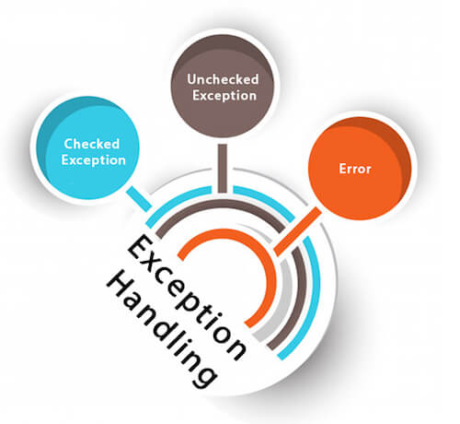

Slide 19
Common Scenarios of Java Exceptions
ArithmeticException
int a=50/0;

Slide 20
Common Scenarios of Java Exceptions
NullPointerException
String s=null;
System.out.println(s.length());

Slide 21
Common Scenarios of Java Exceptions
NumberFormatException
String s="abc";
int i=Integer.parseInt(s);

Slide 22
Common Scenarios of Java Exceptions
ArrayIndexOutOfBoundsException
int a[]=new int[5];
a[10]=50;

Slide 23
Java Exception Keywords
try
catch
finally
throw
throws

Slide 24
try
The "try" keyword is used to specify a block where we should place exception code
The try block must be followed by either catch or finally

Slide 25
catch
The "catch" block is used to handle the exception.
It must be preceded by try block which means we can't use catch block alone
It can be followed by finally block later

Slide 26
finally
The "finally" block is used to execute the important code of the program
It is executed when an exception is handled or not.

Slide 27
throw
The "throw" keyword is used to throw an exception

Slide 28
throws
The "throws" keyword is used to declare exceptions, it doesn't throw an exception
It specifies that there may occur an exception in the method.

Slide 29
Java Exception Handling Example
import java.util.*;
public class Test
{
public static void main(String args[])
{
Scanner s=new Scanner(System.in);
int n=s.nextInt();
for(int i=0; i<=n; i++)
{
try
{
int data=100/i;
}
catch(ArithmeticException e)
{
System.out.println(e);
}
System.out.print(i+" ");
}
}
}
catch block to catch the exception if occurred
Output:
java.lang.ArithmeticException: / by zero
0 1 2 3 4 5 6 7 8 9 10
Calculation in try block

Slide 30
Program with multiple catch
import java.util.*;
public class Test
{
public static void main(String args[])
{
Scanner s=new Scanner(System.in);
int n=s.nextInt();
int arr[]=new int[3];
for(int i=0;i<=n;i++)
{
try
{
int data=100/i;
arr[i]=data;
}
catch(ArithmeticException e)
{
System.out.println(e);
}
catch(ArrayIndexOutOfBoundsException e)
{
System.out.println(e);
}
}
}
}
Output:
java.lang.ArithmeticException: / by zero
java.lang.ArrayIndexOutOfBoundsException: 3
java.lang.ArrayIndexOutOfBoundsException: 4
java.lang.ArrayIndexOutOfBoundsException: 5

Slide 31
Java finally block
Java finally block is always executed whether exception is handled or not.
Java finally block follows try or catch block.

Slide 32
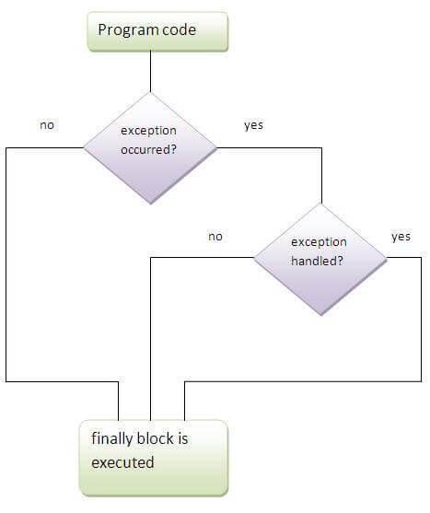
Java finally block

Slide 33
Java finally block- example
import java.util.*;
public class Test
{
public static void main(String args[])
{
Scanner s=new Scanner(System.in);
double data;
int count=0, n=s.nextInt();
for(int i=0;i<=n;i++)
{
try
{
data=100/i;
System.out.println(data+ " ");
}
catch(ArithmeticException e)
{
count++;
System.out.println(e);
}
finally
{
if(i==n)
{
if(count==0 )
System.out.println("No exception ");
else
System.out.println(count +" exception handled");
}
}
}
}
}

Slide 34
Output:
java.lang.ArithmeticException: / by zero
100.0
50.0
33.0
25.0
20.0
16.0
14.0
12.0
11.0
10.0
1 exception handled

Slide 35
Java throw keyword
throw
used to explicitly throw an exception
can throw either checked or unchecked exception

Slide 36
Java throw block- example
import java.util.*;
public class Test
{
static void validate(int age)
{
if(age<18)
throw new ArithmeticException("Under Age");
else
System.out.println("welcome to vote");
}
public static void main(String args[])
{
Scanner s=new Scanner(System.in);
int n=s.nextInt();
validate(n);
}
}
Output:
Exception in thread "main" java.lang.ArithmeticException: Under Age
at Test.validate(Test.java:7)
at Test.main(Test.java:15)
Command exited with non-zero status 1

Slide 37
Till now we discussed about how to deal with unchecked exceptions
What if a checked exception occurs???
throws

Slide 38
throws keyword
throws
used to declare an exception
It gives an information to the programmer that there may occur an exception

Slide 39
throws keyword
Syntax
return_type method_name() throws exception_class_name
{
//method code
}

Slide 40
throws keyword
Example
void method()throws IOException
{
//method code
}

Slide 41
throws keyword example
import java.io.*;
class M
{
void method()throws IOException
{
throw new IOException("device error");
}
}
public class Test
{
public static void main(String args[])throws IOException
{
M m=new M();
m.method();
}
}
Output:
Exception in thread "main" java.io.IOException:device error
at M.method(Test.java:6)
at Test.main(Test.java:14)
Command exited with non-zero status 1

Slide 42
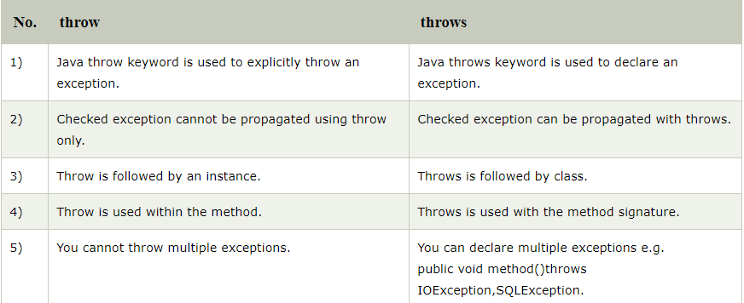
Difference between throw and throws

Slide 43


